Slide 1
Making Sense of DSC Configuration Data
Gael Colas @ SynEdgy Limited

Slide 2


Slide 3
Agenda
Policy-Driven Infrastructure
What we‘re told
Why it does not scale
Workarounds
How to do it?

Slide 4
Policy-Driven Infrastructure
- Infrastructure as Code is the wrong name!
Don Jones‘ „Maybe IaC isn‘t the right way“
Runtime vs Policy
DSC is prescriptive, and it‘s good!
DSC‘s missing bits...
The case for notification/action

Slide 5
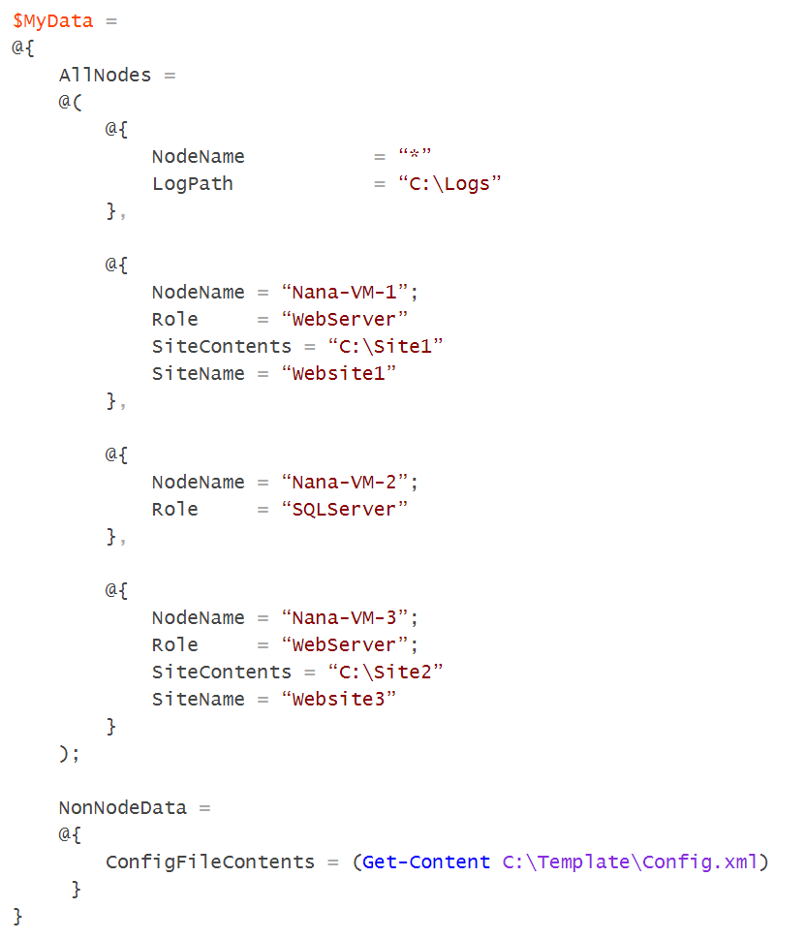
Separating What from Where

Slide 6
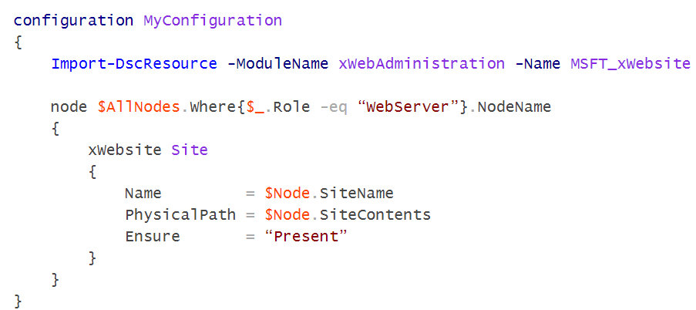
In the Configuration Script

Slide 7
On the field...
We need to:
Manage 2000 nodes
10 sites
3+ Environments
across 30 services
Abstract resources to services:
I want service x in each site…
Hey, we’ve got a new site…

Slide 8
The Case against Named Configuration
One name = one MOF
Multiple Nodes = on one MOF
How do you define Node specific info?
Certificate
Credentials
VM ID?
Workarounds: Not in DSC (Orchestration)

Slide 9
The Case against Partial Config
DSC Partial Configurations are the Devil's Workshop – Steve Murawski
How does it relate to config Data?
Visibility of the Policy

Slide 10
How to store and Manage Config Data?
PSD1 files?
Database / CMDB
Manage Data within custom script?
How do you see and edit the policy?
Is it self documenting?

Slide 11
The Lost way...
DSC Tooling, 2014 – Steve Murawski & Dave Wyatt
Layered approach
AllNodes
SiteData
Services
Credentials
Refreshed here: DscConfigurationData

Slide 12
Demo
DscConfigurationData

Slide 13
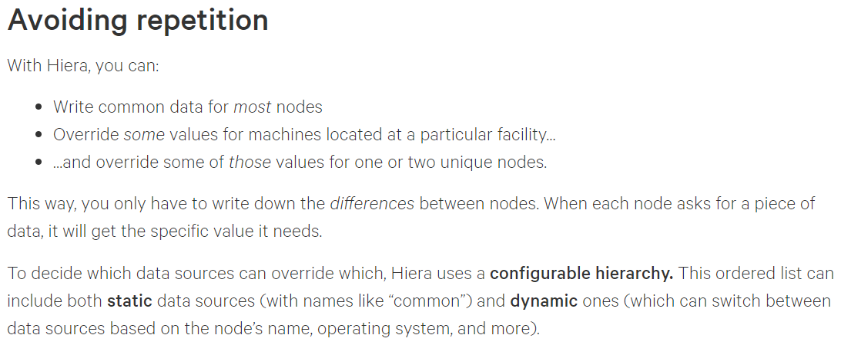
What Others do?
Chef Databags
Puppet Hiera
Runtime Data & Predefined

Slide 14
What DscConfigurationData lacks of?
Dynamic hierarchy (i.e. no Environment layer for instance)
Lookup customisation and declaration
Abstraction of the Storage of Data
Abstraction of the Format of data

Slide 15
Hierachical Data in PowerShell?
File System is nice, but very specific
PS Providers?
Tried Simplex
The at the end of the tunnel PowerShell variables!
New Module: Datum

Slide 16
Demo
Datum

Slide 17
Credentials
Credential is data, but with security needs
If you abstract the storage, pull from Vault
If you store locally for build, encrypt to disk: ProtectedData (By Dave Wyatt)

Slide 18
Summary
Configuration Data is the key
Use override-only, inheritence structure
Make your Policy visible and accessible
Try Datum and give me feedback ☺

Slide 19
Questions?

Slide 20




About_Author
@gaelcolas
Gael Colas Cloud & Windows Automation Consultant
Dev
Ops

Slide 21
Next Steps...
Now: 15 min break
Grab a coffee
Stay here to enjoy next presentation
Change track and switch to another room
Ask me questions or meet me in a breakout session room afterwards

